Slide 1
ASP.NET MVC CORE
Instructor: Edwin oduor

Slide 2

Quote of the day

Slide 3
Lesson objectives
Controllers

Slide 4
Lesson pre-requisites
In order to take full advantage of this section you need to have the following;
Computer with Visual Studio Installed.
Stable Network Connection.

Slide 5
Training methods and extra readings
TRAINING METHODS FOR THIS LESSON
EXTRA READINGS
Lecturing Method – This is the main method of training to be adopted in this lesson with illustrations and practical coding examples.
Discussion Method - This method will be adopted periodically whereby learning will be derived principally from the students brainstorming together, rather than from the trainer. Three main types of discussions will be used:
Directed discussion
Developmental discussion
Problem-Solving discussion
Home and Learn C#

Slide 6
CONTROLLERS

Slide 7
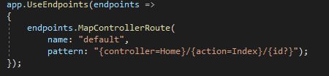
When a user issues a request in their favorite browser it is the work of the Controller to handle the request made. The controller is going to respond to what has been written in the address bar by calling an action based on what is indicated on the address bar.
The question that we can ask our selves is how does the program know which controller to call given a scenario that there are many controllers? This is achieved by configuring the default Route, in this case a default controller that has been set is the one which will be called. In the code below the default has been set to use the Home controller and the Index Action. This is done in the startup.cs file.

Slide 8



A user issues the following request to the browser, when the request is issued then the controller will handle the request for instance in the address the controller will check in the Home controller to determine if there is an IActionResult by the name Register.
From the above images when a request is made the controller is going to know which method to call based on what’s is in the URL. In this case we have Register action to be executed

Slide 9
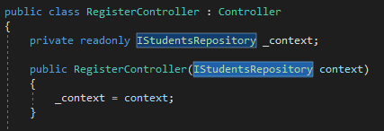
Creating a controller
To create a controller Right Click on controller folder >> Add >> Controller, Choose empty, Give the controller a name in Our case will give it the name RegisterController.
Inside the controller will pass the Interface that we had created earlier the name of the interface is IStudentsRepository so that we can access the methods inside the Repository class that we created. This is how our controller class will look like. We have a read only method and a variable. Once we have the two the next is to write the IAction methods.

Slide 10
When writing the methods we can either decorate them with Post or Get.
Post – When one has some texts in the form and wants to save whatever is in the text fields into the database then the post method will be used.
Get - On the other hand when one wants to display the content or Request for data from either a file or database and show them to the user then the Get method will be used. Will understand this more as we continue with writing the code and doing them practically.
When the program is executed for the first time its going to go to the home controller and load the index Action because that is what has been set. But in our case will be adding more actions in the Register Controller.

Slide 11
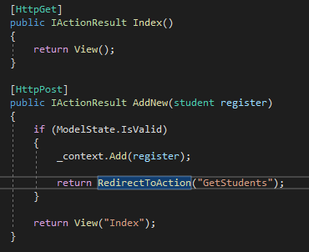
Let’s have a look at the methods that will have in RegisterController.
Methods in the Register Controller
The first method is the get Method, this method is going to display for us a form to register students details. Will be creating a view for it later.
The second Action is the Post Action what its doing is it will have what the user has typed in the form and save it in the table

Slide 12
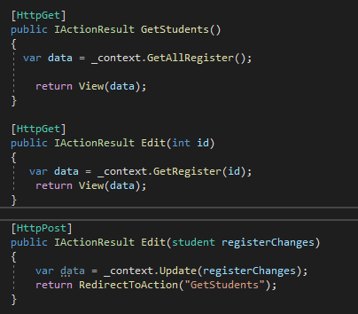
Let’s have a look at the methods that will have in RegisterController.
Methods in the Register Controller
In this slide the first method is used to display list of all students.
The second method get method when this method is called its going to retrieve the record using it’s Id and display it on the form.
The third record is now the one for making the changes and saving in the database.

Slide 13
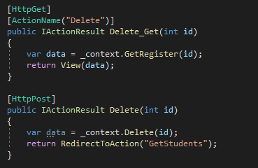
Let’s have a look at the methods that will have in RegisterController.
Methods in the Register Controller
The first method in this slide is a get method when called it’s going to retrieve the record using the id and display it on the browser.
The second one is the post method the one that is now going to permanently delete the content from the table in the database.

